Slide 1
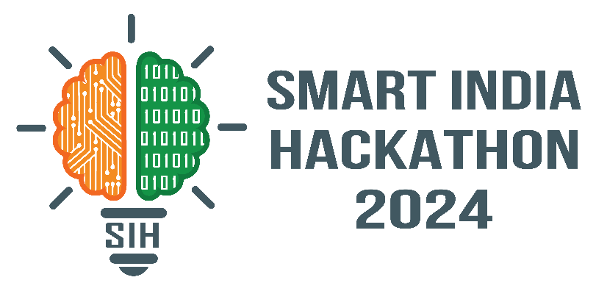
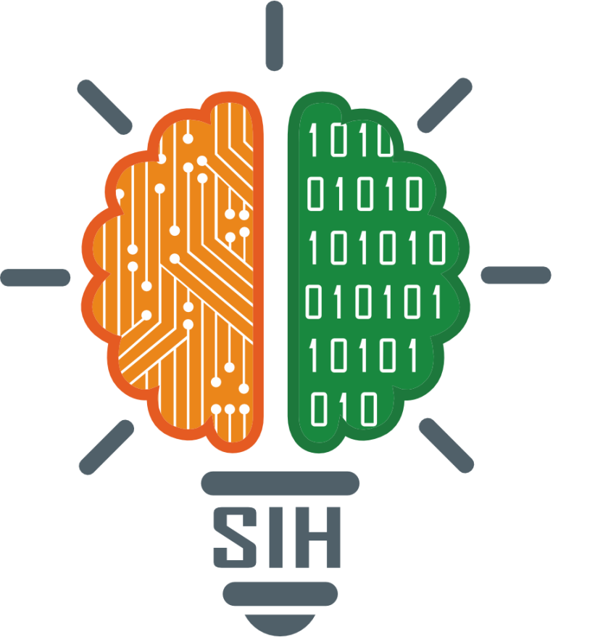
SMART INDIA HACKATHON 2024
TITLE PAGE
SIH1537
Biometric Authentication for Accident
Victims using IOT
Medtech/biotech/healthtech
PS Category- Hardware
Tech Developers

Slide 2
BIOMETRIC AUTHENTICATION FOR ACCIDENT VICTIMS USING IOT
Tech
Developers
IDEA / SOLUTION:
Problem Resolution:
Robust biometric security thrives in low-network zones, providing seamless authentication and unparalleled reliability.
Family members Receive instant alerts and notifications, ensuring they stay informed and up-to-date
Implementation of a Biometric Authentication For Accident Victims Using IOT ,Specialized for emergency situations.
Thumbprint Unlocks unconscious patients profiles.
With a thumbprint scan, patients pre-registered medical information is Immediately accessed.
Once retrieved, the patient's information is Automatically dispatched to their designated family contacts and previous treating hospitals.
Capability to Work efficiently without any time Delay.
Unique Value Proposition(UVP):
Quickly verify victim identities to expedite medical treatment and notify emergency contacts.
Access vital medical information and history in real-time, ensuring informed treatment decisions.
Protect sensitive information and prevent identity fraud in emergency situations.

Slide 3
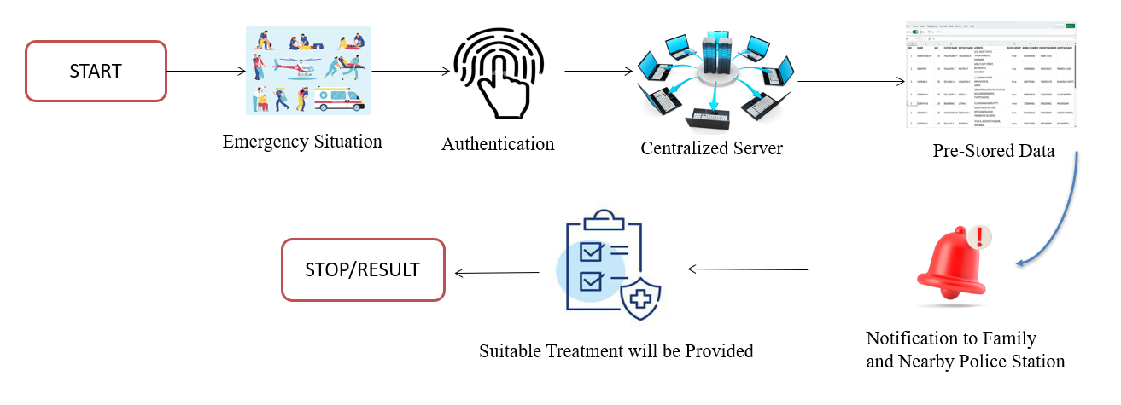
TECHNICAL APPROACH
Tech
Developers
PROCESS FLOW ARCHITECTURE:
HARDWARE:
Finger Print Sensor(RC307)
Arduino Controller
LCD Display
IOT Module
Voltage Regulator(9V)
SOFTWARE:
Arduino IDE Compiler
Proteus Testing Tool
Embedded C
Product Status:50% product built completed and further build is on progress . Collecting Data base are next to be undergone.

Slide 4
FEASIBILITY AND VIABILITY
Tech
Developers
ANALYSIS OF THE FEASIBILITY:
POTENTIAL CHALLENGES:
Security and Privacy Risks:
Technical Feasibility:
Data breaches and unauthorized access, Identity theft and fraud, Privacy concerns.
Biometric sensors, IoT devices, and data solutions are readily available and can be easily integrated with existing emergency response systems.
Operational Challenges:
User acceptance and adoption , Training and education, Workflow integration, Continuous monitoring and evaluation
Economic Feasibility:
STRATEGIES FOR OVERCOMING:
Although the initial investment in IoT technology is significant, it can yield substantial cost savings and efficiency gains in the long run.
Stay compliant with regulations, mitigate liability with clear guidelines, and obtain informed patient consent. Foster a culture of accountability and continuous learning to ensure responsible use of biometric authentication

Slide 5
IMPACT AND BENEFITS
Tech Developers
POTENTIAL IMPACT:
BENEFITS OF THE SOLUTION:
POSITIVE IMPACT:
Enhanced Patient Experience: Biometric authentication and IoT devices can reduce anxiety and stress for patients and their families.
Improved Data Analysis: Real-time data collection enables analysis of accident trends, leading to improved prevention strategies.
Cost Savings: Reduced administrative tasks, improved response times, and streamlined treatment can lead to cost savings.
Enhanced Collaboration: IoT devices and biometric authentication facilitate collaboration among emergency responders, medical professionals, and family members
Quick Identification
Medical History Access
Enhanced Patient Care
Streamlined Treatment
NEGATIVE IMPACT:
Security Risk
Inaccurate Readings
Liability Issues
Data Overloaded

Slide 6
RESEARCH AND REFERENCES
Tech
Developers
"IoT-based Biometric Authentication for Accident Victims" by S. S. Rao et al., published in the International Journal of Advanced Research in Computer Science and Software Engineering (IJARCSSE), Volume 9, Issue 3, 2020.
"A Secure IoT-Based Biometric Authentication System for Accident Victims" by R. K. Challa et al., published in the Wiley Journal of Software: Practice and Experience, Volume 53, Issue 3, 2023.
"IoT-based Biometric Authentication System for Accident Victims" by R. K. Sharma et al., published in the International Journal of Engineering and Advanced Technology (IJEAT), Volume 9, Issue 4, 2020.
"Biometric Authentication for Accident Victims using IoT and Blockchain" by A. Kumar et al., published in the Elsevier Journal of Network and Computer Applications, Volume 218, 2023.
"Biometric Authentication for Accident Victims using IoT and Machine Learning" by A. Kumar et al., published in the International Journal of Machine Learning and Computing (IJMLC), Volume 10, Issue 3, 2020.

